Slide 1
Concurrency in Shared Memory
Sketches

Slide 2
Concurrency in Hardware
Spatial separation of processing components
Minimise communication!

Slide 3
Concurrency in Hardware
Spatial separation of processing components
Minimise communication!
Ensuring an interleaving semantics for parallel composition requires a lot of communication:
each hardware is proposing a different ‘relaxation’

Slide 4
Concurrency in Hardware
Spatial separation of processing components
Minimise communication!
Ensuring an interleaving semantics for parallel composition requires a lot of communication:
each hardware is proposing a different ‘relaxation’
Interleaving semantics (sequential consistency) is so intuitive, because it is compatible with the idea of an absolute time => total order of events
and of a monolithic memory, in that at each instant a unique view of it exists
Notes:
.

Slide 5
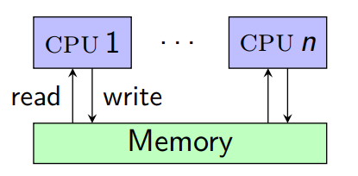
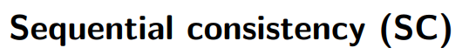
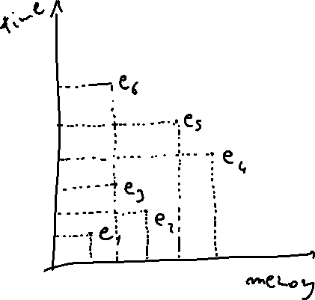
Concurrency in Hardware
An event is described by
( CPU, time, address, action, value )

Slide 6
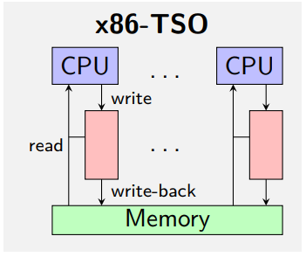
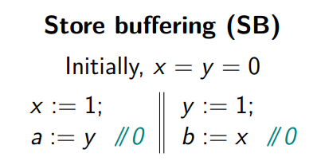
Concurrency in Hardware

Slide 7
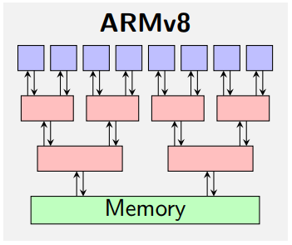
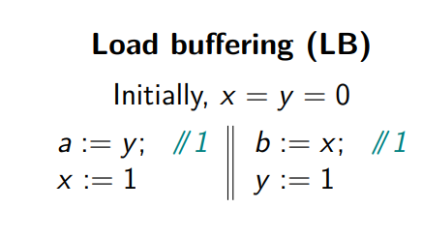
Concurrency in Hardware

Slide 8
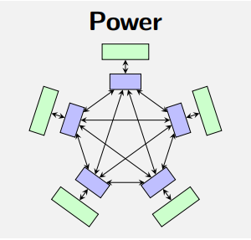
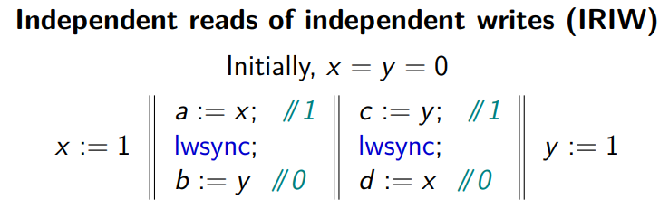
Concurrency in Hardware

Slide 9
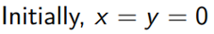
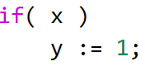
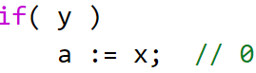
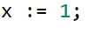
Concurrency in Hardware
Non-multicopy atomic (non-MCA)

Slide 10
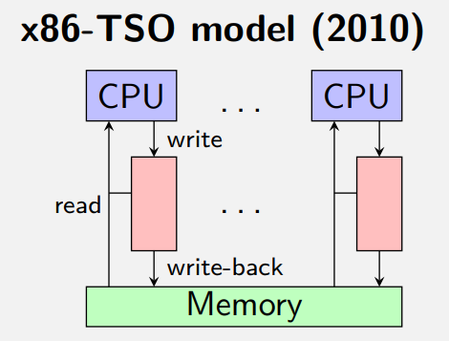
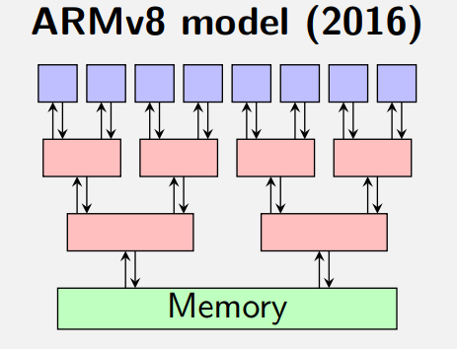


Concurrency in Hardware
In weak memory models the shared memory is not seen directly by the CPUs – there are buffers in the middle… and more, to enhance locality.
Since CPU=observer, to be able to reason intuitively about
programs it seems useful to derive a description of an idealised memory
which, beholding some prescription, enable us to model what can be seen by the observers without keeping track of the particular hardware layout. Indeed, vendors are not even giving a detailed description of their hardware…

Slide 11
Concurrency in Hardware
Empirical approach: hardware observable behaviour is extrapolated and checked against the available hardware model (in prose) through litmus test generators
Since CPU=observer, to be able to reason intuitively about
programs it seems useful to derive a description of an idealised memory
which, beholding some prescription, enable us to model what can be seen by the observers without keeping track of the particular hardware layout. Indeed, vendors are not even giving a detailed description of their hardware…

Slide 12
Concurrency in Hardware
Interplay of Hardware Architects and formal methods researchers => good stuff!
Empirical approach: hardware observable behaviour is extrapolated and checked against the available hardware model (in prose) through litmus test generators
Since CPU=observer, to be able to reason intuitively about
programs it seems useful to derive a description of an idealised memory
which, beholding some prescription, enable us to model what can be seen by the observers without keeping track of the particular hardware layout. Indeed, vendors are not even giving a detailed description of their hardware…

Slide 13
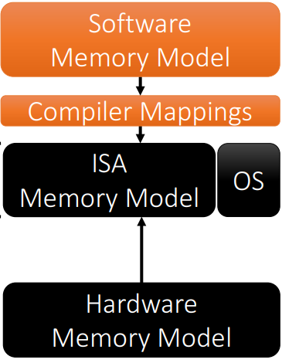
Concurrency in Hardware
Concurrency models should survive through many layers
Interplay of Hardware Architects and formal methods researchers => good stuff!
Empirical approach: hardware observable behaviour is extrapolated and checked against the available hardware model (in prose) through litmus test generators
Since CPU=observer, to be able to reason intuitively about
programs it seems useful to derive a description of an idealised memory
which, beholding some prescription, enable us to model what can be seen by the observers without keeping track of the particular hardware layout. Indeed, vendors are not even giving a detailed description of their hardware…

Slide 14
Concurrency
The empirical, bottom up approach is a necessary starting move, but after years of experience a more synthetic approach is needed
Top Down: realistic (implementable), perfomant and usable memory models covering the full stack of layers, encapsulated in high level programming language (C/C++/Java…)

Slide 15
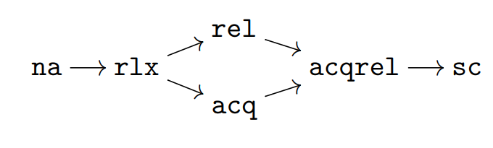

Concurrency in C11
ops on ATOMICs, for concurrent access

Slide 16
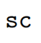

Concurrency in C11
Sequential consistency = interleaving

Slide 17
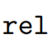
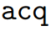



Concurrency in C11
Sequential consistency = interleaving
Release = no reads or writes in the current thread can be reordered after this store
Acquire = no reads or writes in the current thread can be reordered before this load

Slide 18
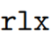

Concurrency in C11
Sequential consistency = interleaving
Release = no reads or writes in the current thread can be reordered after this store
Acquire = no reads or writes in the current thread can be reordered before this load
Relaxed = only this operation's atomicity is guaranteed + coherence + ?

Slide 19
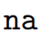

Concurrency in C11
Sequential consistency = interleaving
Release = no reads or writes in the current thread can be reordered after this store
Acquire = no reads or writes in the current thread can be reordered before this load
Relaxed = only this operation's atomicity is guaranteed + magic
Not atomic = every race is undefined behaviour

Slide 20
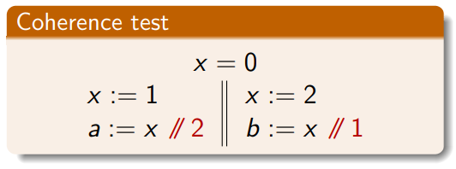
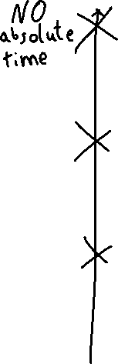
Intuition on C11 relaxed memory model
only this operation's atomicity is guaranteed = coherence (COH)

Slide 21
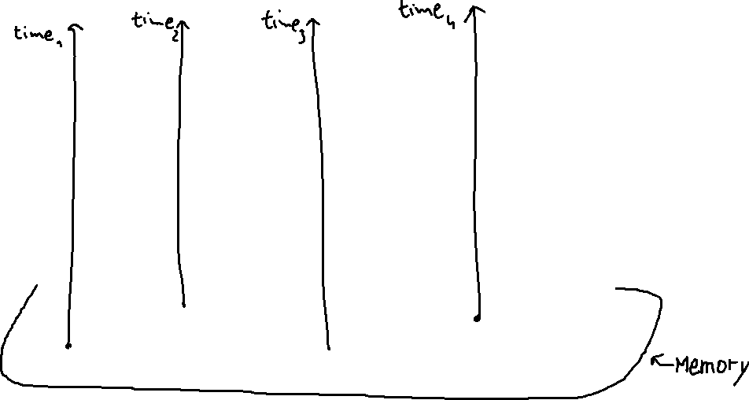
Intuition on C11 relaxed memory model
(COHERENCE) Each memory location has its own ‘clock’, but each time arrow has the same direction… in which sense?

Slide 22



Intuition on C11 relaxed memory model
(COHERENCE) Each memory location has its own ‘clock’, but each time arrow has the same direction… in which sense?
For a given execution, to each memory address we can associate a sequence of values.

Slide 23
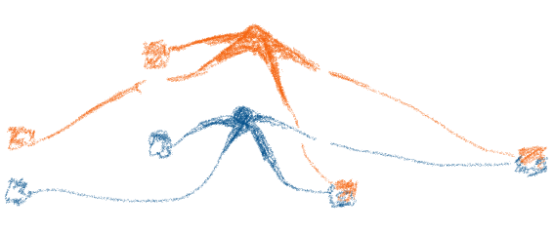
Intuition on C11 relaxed memory model
(COHERENCE) Each memory location has its own ‘clock’, but each time arrow has the same direction… in which sense?
For a given execution, to each memory address we can associate a sequence of values.
For each memory location, each thread can access a subsequence of the sequence of values => local total order

Slide 24
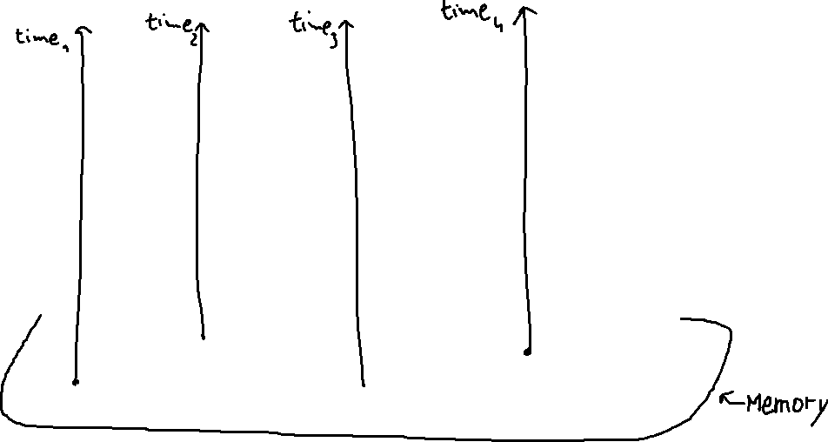
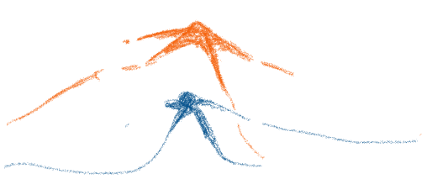






Intuition on C11 relaxed memory model
(COHERENCE) Each memory location has its own ‘clock’, but each time arrow has the same direction… in which sense?
For a given execution, to each memory address we can associate a sequence of values.
For each memory location, each thread can access a subsequence of the sequence of values => local total order

Slide 25
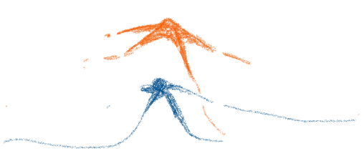









Intuition on C11 relaxed memory model
(COHERENCE) Each memory location has its own ‘clock’, but each time arrow has the same direction… in which sense?
For a given execution, to each memory address we can associate a sequence of values.
For each memory location, each thread can access a subsequence of the sequence of values => local total order

Slide 26







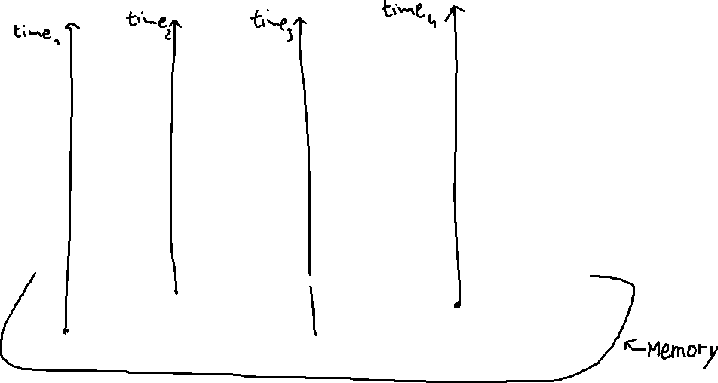

Intuition on C11 relaxed memory model
(COHERENCE) Each memory location has its own ‘clock’, but each time arrow has the same direction… in which sense?
For a given execution, to each memory address we can associate a sequence of values.
For each memory location, each thread can access a subsequence of the sequence of values => local total order

Slide 27







Intuition on C11 relaxed memory model
(COHERENCE) Each memory location has its own ‘clock’, but each time arrow has the same direction… in which sense?
For a given execution, to each memory address we can associate a sequence of values.
For each memory location, each thread can access a subsequence of the sequence of values => local total order

Slide 28




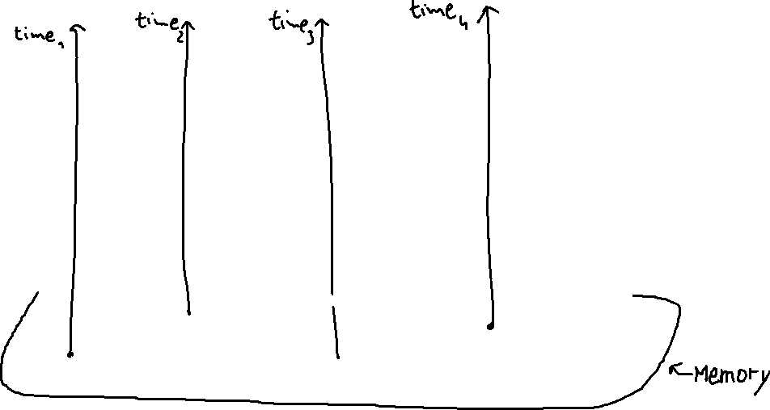

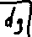

Intuition on C11 relaxed memory model
(COHERENCE) Each memory location has its own ‘clock’, but each time arrow has the same direction… in which sense?
For a given execution, to each memory address we can associate a sequence of values.
For each memory location, each thread can access a subsequence of the sequence of values => local total order

Slide 29
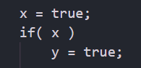
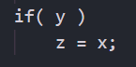
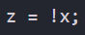


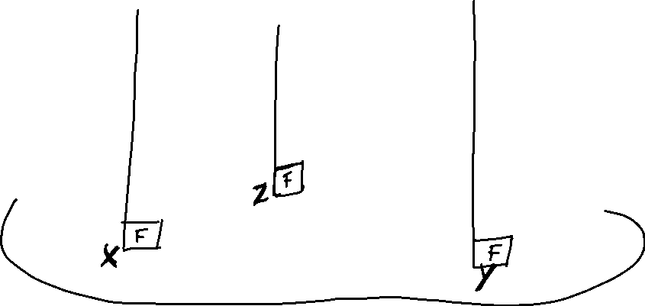



Intuition on C11 relaxed memory model
Causality?!? In the case, z should be false at the end of any execution

Slide 30




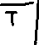



Intuition on C11 relaxed memory model
Causality?!?

Slide 31






Intuition on C11 relaxed memory model
Causality?!?

Slide 32



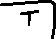




Intuition on C11 relaxed memory model
Causality?!?

Slide 33








Intuition on C11 relaxed memory model
Causality?!?

Slide 34


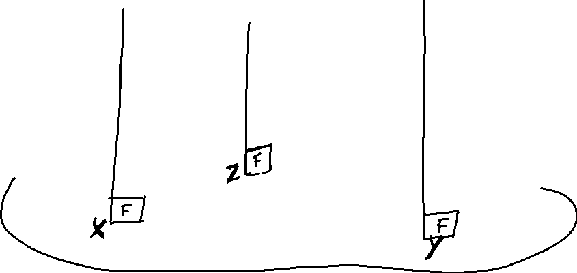











Intuition on C11 relaxed memory model
Causality?!?

Slide 35
Intuition on C11 relaxed memory model
Causality?!?
Without causality, it is easy to fall in the trap of cyclic dependencies

Slide 36
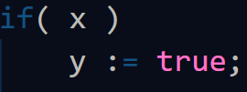
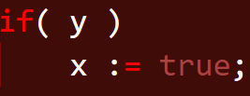


Intuition on C11 relaxed memory model
Causality?!?
Without causality, it is easy to fall in the trap of cyclic dependencies

Slide 37
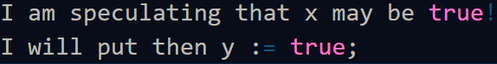
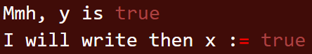
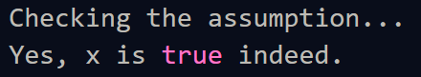
Intuition on C11 relaxed memory model
Causality?!?
Without causality, it is easy to fall in the trap of cyclic dependencies

Slide 38
Intuition on C11 relaxed memory model
Causality?!?
Without causality, it is easy to fall in the trap of cyclic dependencies
This is not observable in any hardware+compiler, by now. In hardware, speculation is thread local indeed: speculative values are invisible to other threads.

Slide 39
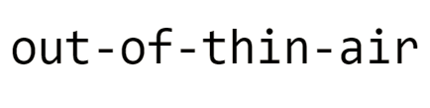
Intuition on C11 relaxed memory model
Causality?!?
Without causality, it is easy to fall in the trap of cyclic dependencies

Slide 40
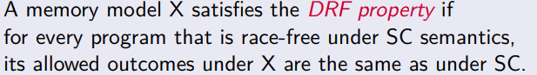
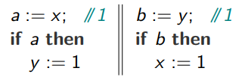
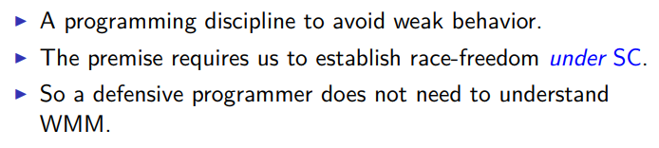
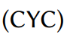
I don’t care about OOTA!
COH does not satisfy the DRF property

Slide 41
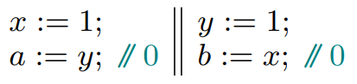








COH by Operational Semantics
How to build an execution from the source?
In previous executions, I omitted the choices to be made.
I actually preserved the program order in the execution order,
and each thread was writing only on the top of the memory local queue of values.
This is enough to allow WR (writes reordered after independent reads) = Store Buffer

Slide 42






COH by Operational Semantics
How to build an execution from the source?
In previous executions, I omitted the choices to be made.
I actually preserved the program order in the execution order,
and each thread was writing only on the top of the memory local queue of values.
This is enough to allow WR (writes reordered after independent reads) = Store Buffer

Slide 43

COH by Operational Semantics
How to build an execution from the source?
In previous executions, I omitted the choices to be made.
I actually preserved the program order in the execution order,
and each thread was writing only on the top of the memory local queue of values.
What about WW (reordering of independent writes)?

Slide 44


COH by Operational Semantics
How to build an execution from the source?
In previous executions, I omitted the choices to be made.
I actually preserved the program order in the execution order,
and each thread was writing only on the top of the memory local queue of values.
What about WW (reordering of independent writes)? At least one of the two ‘1’ assignments will be executed after the corresponding ‘2’ assignment in any interleaving execution…

Slide 45
COH by Operational Semantics
How to build an execution from the source?
In previous executions, I omitted the choices to be made.
I actually preserved the program order in the execution order,
and each thread was writing only on the top of the memory local queue of values.
What about WW (reordering of independent writes)? At least one of the two ‘1’ assignments will be executed after the corresponding ‘2’ assignment in any interleaving execution…

Slide 46












COH by Operational Semantics
How to build an execution from the source?
In previous executions, I omitted the choices to be made.
I actually preserved the program order in the execution order.
What about WW (reordering of independent writes)? At least one of the two ‘1’ assignments will be executed after the corresponding ‘2’ assignment in any interleaving execution…

Slide 47








COH by Operational Semantics
How to build an execution from the source?
In previous executions, I omitted the choices to be made.
I actually preserved the program order in the execution order.
What about WW (reordering of independent writes)? At least one of the two ‘1’ assignments will be executed after the corresponding ‘2’ assignment in any interleaving execution…

Slide 48
COH by Operational Semantics
How to build an execution from the source?
In previous executions, I omitted the choices to be made.
I actually preserved the program order in the execution order.
What about WW (reordering of independent writes)? At least one of the two ‘1’ assignments will be executed after the corresponding ‘2’ assignment in any interleaving execution…

Slide 49




COH by Operational Semantics
How to build an execution from the source?
In previous executions, I omitted the choices to be made.
I actually preserved the program order in the execution order.
What about RW (reordering of a read after an independent write)? Load Buffering

Slide 50

COH by Operational Semantics
How to build an execution from the source?
In previous executions, I omitted the choices to be made.
I actually preserved the program order in the execution order.
Kind of «out of order» execution
SB by «reading in the past», LB by «reading in the future»
What about RW (reordering of a read after an independent write)? Load Buffering

Slide 51

COH by Operational Semantics
How to build an execution from the source?
In previous executions, I omitted the choices to be made.
Kind of «out of order» execution
which future?
Promising Semantics
SB by «reading in the past», LB by «reading in the future»
What about RW (reordering of a read after an independent write)? Load Buffering

Slide 52






COH by Operational Semantics
How to build an execution from the source?
In previous executions, I omitted the choices to be made.
which future?
Promising Semantics
SB by «reading in the past», LB by «reading in the future»
What about RW (reordering of a read after an independent write)? Load Buffering

Slide 53






COH by Operational Semantics
How to build an execution from the source?
In previous executions, I omitted the choices to be made.
which future?
Promising Semantics
SB by «reading in the past», LB by «reading in the future»
What about RW (reordering of a read after an independent write)? Load Buffering

Slide 54





COH by Operational Semantics
How to build an execution from the source?
In previous executions, I omitted the choices to be made.
which future?
Promising Semantics
SB by «reading in the past», LB by «reading in the future»
What about RW (reordering of a read after an independent write)? Load Buffering

Slide 55






COH by Operational Semantics
How to build an execution from the source?
In previous executions, I omitted the choices to be made.
which future?
Promising Semantics
SB by «reading in the past», LB by «reading in the future»
What about RW (reordering of a read after an independent write)? Load Buffering

Slide 56





COH and operational «promising» semantics

Slide 57


COH and operational «promising» semantics

Slide 58
COH and operational «promising» semantics
A thread T may nondeterministically “promise” to write a value v to a memory location x at some point in the future
From the point of view of other threads, a promise is no different from an ordinary write
In contrast, T cannot read from its own promised write until T has fulfilled the promise
Allow T to promise to write v to x if it is possible to thread-locally certify that the promise can be fulfilled in a finite number of steps. Every step a thread takes, it must re-certify all its outstanding promises to make sure they can still be fulfilled

Slide 59














Weird promises

Slide 60






Weird promises

Slide 61




Weird promises

Slide 62

Weird promises

Slide 63





Weird promises

Slide 64
So promises are not perfect
It disallows a weak behavior for fetch-add supported by ARMv8
The high degree of non determinism makes it hard to exhaustively explore all possible behaviors of a given program
Anyhow it provides DRF guarantees, distinguishes between CYC and LB, and it is a refinement of a naïve operational semantics.
Better solutions?
A different strategy, rooted in game semantics via event structures

Slide 65

COH & OOTA

Slide 66











COH & OOTA
4

Slide 67

COH & OOTA
4

Slide 68




COH & OOTA
4

Slide 69
COH & OOTA
4

Slide 70









COH & OOTA
May seem complicated, but it is not! Deduce by «bad patterns»:
4

Slide 71










COH & OOTA: strenghtening COH?
4

Slide 72





COH & OOTA: strenghtening COH?
4

Slide 73












COH & OOTA: event structures
program order
justifies-from
conflict

Slide 74




COH & OOTA: event structures
program order
justifies-from
conflict

Slide 75
COH & OOTA: event structures
program order
justifies-from
modification order: we can enforce a modification order (coherence) on each execution (WEAKEST model) or on the event structure itself (WEAKESTMO model)
conflict
equal-write

Slide 76



COH & OOTA: event structures
Not allowed by WEAKESTMO
program order
justifies-from
conflict
equal-write
modification order

Slide 77






COH & OOTA: event structures
weaker than
weaker than
?
?

Slide 78
COH & OOTA: event structures
?
Efficient model-checking without acyclicity?
?
Adapting litmus test generators to this model?
?
?

Slide 79
[ … ] 2011 :: Mathematizing C++ Concurrency - Batty : Owens : Sarkar : Sewell : Weber 2012 :: A formal hierarchy of weak memory models - Alglave 2014 :: Herding cats: Modelling, Simulation, Testing, and Data-mining for Weak Memory - Alglave : Maranget : Tautschnig 2015 :: The Problem of Programming Language Concurrency Semantics - Batty : Memarian : Nienhuis : Pichon-Pharabod : Sewell 2015 :: Weak memory models using event structures - Castellan 2015 :: Common compiler optimisations are invalid in the C11 memory model and what we can do about it - Vafeiadis : Balabonski : Chakraborty : Morisset : Nardelli 2017 :: Compiler Optimisations and Relaxed Memory Consistency Models - Morisset 2016 :: A Concurrency Semantics for Relaxed Atomics that Permits Optimisation and Avoids Thin-Air Executions - Pichon-Pharabod : Sewell 2017 :: Games and Strategies as Event Structures - Castellan : Clairambault : Rideau : Winskel 2017 :: A Promising Semantics for Relaxed-Memory Concurrency - Kang : Hur : Lahav : Vafeiadis : Dreyer 2017 :: Repairing Sequential Consistency in C/C++11 - Lahav : Vafeiadis : Kang : Hur : Dreyer 2017 :: Automated Synthesis of Comprehensive Memory Model Litmus Test Suites - Lustig : Wright : Papakonstantinou : Giroux 2017 :: Automatically comparing memory consistency models – Wickerson : Batty : Sorensen : Constantinides 2018 :: Promising-ARM/RISC-V: a simpler and faster operational concurrency model - Pulte : Pichon-Pharabod : Kang : Lee : Hur 2018 :: Reconciling High-Level Optimizations and Low-Level Code in LLVM - Lee : Hur : Jung : Liu : Regehr : Lopes 2018 :: Frightening small children and disconcerting grown-ups: Concurrency in the Linux kernel - Alglave : Maranget : McKenney : Parri : Alan 2018 :: Towards Understanding the Costs of Avoiding Out-of-Thin-Air Results - Ou : Demsky 2018 :: A separation logic for a promising semantics - Svendsen : Pichon-Pharabod : Doko : Lahav : Vafeiadis 2018 :: Full-Stack Memory Model Verification with TriCheck - Trippel : Manerkar : Lustig : Pellauer : Martonosi 2018 :: Simplifying ARM Concurrency: Multicopy-Atomic Axiomatic and Operational Models for ARMv8 - Pulte: Flur : Deacon : French : Sarkar : Sewell 2018 :: Constructing a Weak Memory Model – Zhang : Vijayaraghavan : Wright : Arvind 2019 :: Bridging the Gap between Programming Languages and Hardware Weak Memory Models - Podkopaev: Lahav : Vafeiadis 2019 :: Grounding Thin-Air Reads with Event Structures - Chakraborty : Vafeiadis

Slide 80
?

Slide 81


Quick Exercise
[X=0; Y=0]
L(X,0)
L(X,1)
L(Y,1)
L(Y,0)
S(X,1)
S(Y,1)
S(X,1)
S(X,1)

Slide 82
https://www.cl.cam.ac.uk/~pes20/arm-supplemental/arm001.html
https://johnwickerson.github.io/memalloy
http://alloytools.org/

Slide 83


Slide 84


Slide 85


Slide 86


Slide 87


Slide 88


Slide 89


Slide 90


Slide 91


